Slide 1


NSF cloud Chameleon:
Phase 2 Networking
Paul Ruth
RENCI – UNC Chapel Hill
pruth@renci.org

Slide 2
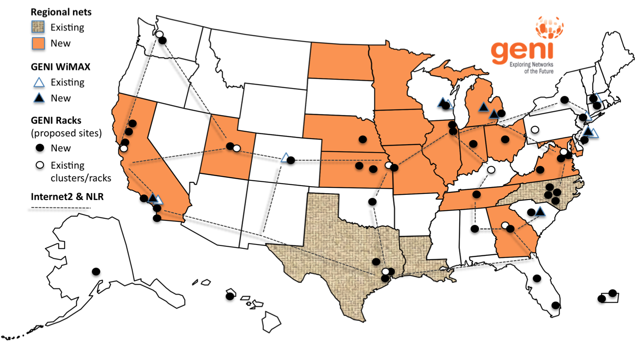
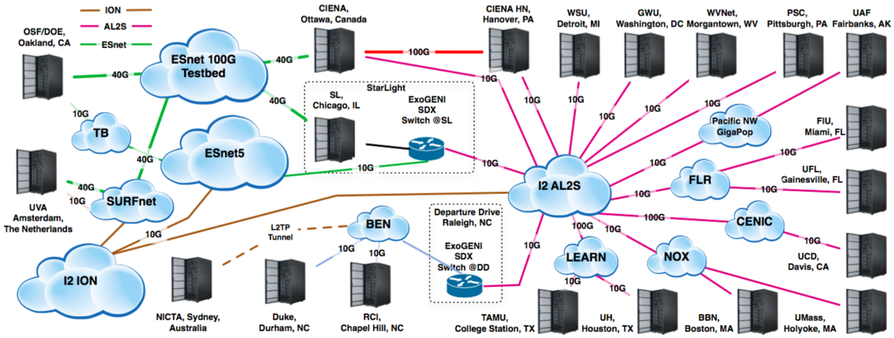
BackGround:
ExoGENI
2
Notes:
ExoGENI
About 20 sites
Each is small OpenStack cloud
Dynamic provisioning of L2 paths between them (sometime from a pool of existing vlans)

Slide 3

Chameleon: Current
Switch
Standard Cloud Unit
42 compute
4 storage
x2
To UTSA, GENI, Future Partners
Core Services
Front End and Data Mover Nodes
504 x86 Compute Servers
48 Dist. Storage Servers
102 Heterogeneous Servers
16 Mgt and Storage Nodes
Chameleon Core Network
100Gbps uplink public network
(each site)
Chicago
SCUs connect to core and fully connected to each other
Austin
Switch
Standard Cloud Unit
42 compute
4 storage
x10
Heterogeneous Cloud Units
ARMs, Atoms, low power Xeions, FPGAs, GPUs, SSDs, etc.
Core Services
3.6 PB Central File Systems, Front End and Data Movers
Notes:
A flash by slide that shows that Chameleon is distributed over 2 sites connected by a 100Gbps network – the details are on the next.

Slide 4
NEW hardware in Phase 2
4 new Standard Cloud Units (32 node racks in 2U chassis)
  3x Intel Xeon “Sky Lake” racks (2x @UC, 1x @TACC) in Y1
  1x future Intel Xeon rack (@TACC) in Y2
Corsa DP2000 series switches in Y1
  2x DP2400 with 100Gbps uplinks (@UC)
  1x DP2200 with 100Gbps uplink (@TACC)
  Each switch will have a 10 Gbps connection to nodes in the SCU
  Optional Ethernet connection in both racks
More storage configurations
  Global store @UC: 5 servers with 12x10TB disks each
  Additional storage @TACC: 150 TB of NVMes
Accelerators: 16 nodes with 2 Volta GPUs (8@UC, 8@TACC)
Maintenance, support and reserve
Notes:
To provide the most configurability in the testbed, the two new Skylake SCUs at Chicago will each be outfitted with a DP2400 switch; each will provide a 10G connection to all 32 nodes in the SCU. These switches have two 100Gb uplinks; one each will be hooked to the UC core network which will be upgraded to handle these connections, and one each will be hooked to the other to provide a fully configurable 100Gb east-west connection between the racks. This will allow the ability to test both within and between rack configurations. A single DP2200 switch will be added to the new SCU at TACC, also connected to the TACC core at 100Gb with 10Gb connections to each of the 32 nodes. This will allow 100Gb end-to-end testing over the WAN with full SDN capability at each end.

Slide 5
NEW hardware in Phase 2
4 new Standard Cloud Units (32 node racks in 2U chassis)
  3x Intel Xeon “Sky Lake” racks (2x @UC, 1x @TACC) in Y1
  1x future Intel Xeon rack (@TACC) in Y2
Corsa DP2000 series switches in Y1
  2x DP2400 with 100Gbps uplinks (@UC)
  1x DP2200 with 100Gbps uplink (@TACC)
  Each switch will have a 10 Gbps connection to nodes in the SCU
  Optional Ethernet connection in both racks
More storage configurations
  Global store @UC: 5 servers with 12x10TB disks each
  Additional storage @TACC: 150 TB of NVMes
Accelerators: 16 nodes with 2 Volta GPUs (8@UC, 8@TACC)
Maintenance, support and reserve
Notes:
To provide the most configurability in the testbed, the two new Skylake SCUs at Chicago will each be outfitted with a DP2400 switch; each will provide a 10G connection to all 32 nodes in the SCU. These switches have two 100Gb uplinks; one each will be hooked to the UC core network which will be upgraded to handle these connections, and one each will be hooked to the other to provide a fully configurable 100Gb east-west connection between the racks. This will allow the ability to test both within and between rack configurations. A single DP2200 switch will be added to the new SCU at TACC, also connected to the TACC core at 100Gb with 10Gb connections to each of the 32 nodes. This will allow 100Gb end-to-end testing over the WAN with full SDN capability at each end.

Slide 6
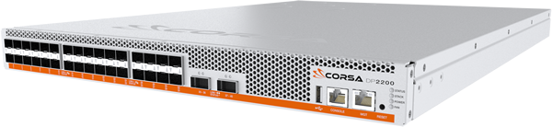
Corsa DP2000 Series Switches
Hardware Network Isolation
  Sliceable Network Hardware
  Tenant controlled Virtual Forwarding Contexts (VFC)
Software Defined Networking (SDN)
  OpenFlow v1.3
  User defined controllers
Performance
  10 Gbps within a site
  100 Gbps between UC/TACC (Aggregated)
Notes:
Using open, programmable APIs, it is possible to create logical switches within a physical switch, in order to isolate network resources for different customers, or business use cases needing different policies, all while running on the same, shared infrastructure.

Slide 7
Network Hardware
Internet 2 AL2S, GENI, Future Partners
Chameleon Core Network
100Gbps uplink public network
(each site)
100 Gbps (Aggregate)
Stacked Switches
(Logically One)
100 Gbps (Aggregate)
Standard Cloud Unit
Standard Cloud Unit
Standard Cloud Unit
Corsa DP2400
Corsa DP2400
Corsa DP2200
Chicago
Austin
Notes:
Design strategy for hardware:
Large homogenous partition
Support for data intensive computing
Introduce diversity horizontally and vertically

Slide 8


Isolated Virtual SDN Switch
Provide Isolated Networks (~Spring 2018)
BYOC– Bring your own controller: isolated user controlled virtual OpenFlow switches (~Summer 2018)
Corsa Switch
Standard Cloud Unit
VFC
(Tenant A)
VFC
(Tenant B)
Compute
Node
(Tenant A)
Compute
Node
(Tenant A)
Compute
Node
(Tenant B)
Compute
Node
(Tenant B)
OpenFlow Controller (Tenant A)
Ryu
OpenFlow Controller (Tenant B)

Slide 9

Chameleon: SDN Experiments
Internet 2 AL2S, GENI, Future Partners
Chameleon Networking
  RENCI added to the team
Hardware Network Isolation
  Corsa DP2000 series
  OpenFlow v1.3
  Sliceable Network Hardware
  Tenant controlled Virtual Forwarding Contexts (VFC)
Isolated Tenant Networks
  BYOC – Bring your own controller
Wide-area Stitching
  Between Chameleon Sites (100 Gbps)
  ExoGENI
  Campus networks (ScienceDMZs)
Austin
Chameleon Core Network
100Gbps uplink public network
Chicago
Corsa
DP2400
Switch
Standard Cloud Unit
VFC
(Tenant A)
VFC
(Tenant b)
Compute
Node
(Tenant A)
Compute
Node
(Tenant A)
Compute
Node
(Tenant B)
Compute
Node
(Tenant B)
OpenFlow Controller (Tenant A)
Ryu
OpenFlow Controller (Tenant B)
Notes:
oals:
-production testbed for SDN experimentation (production?)
-high-bandwidth wide-area SDN experiments
Gaps:
-Testbed for users to experimenting with wide-area SDN
-Isolation below VLAN
-looking forward to creating “network appliances”

Slide 10
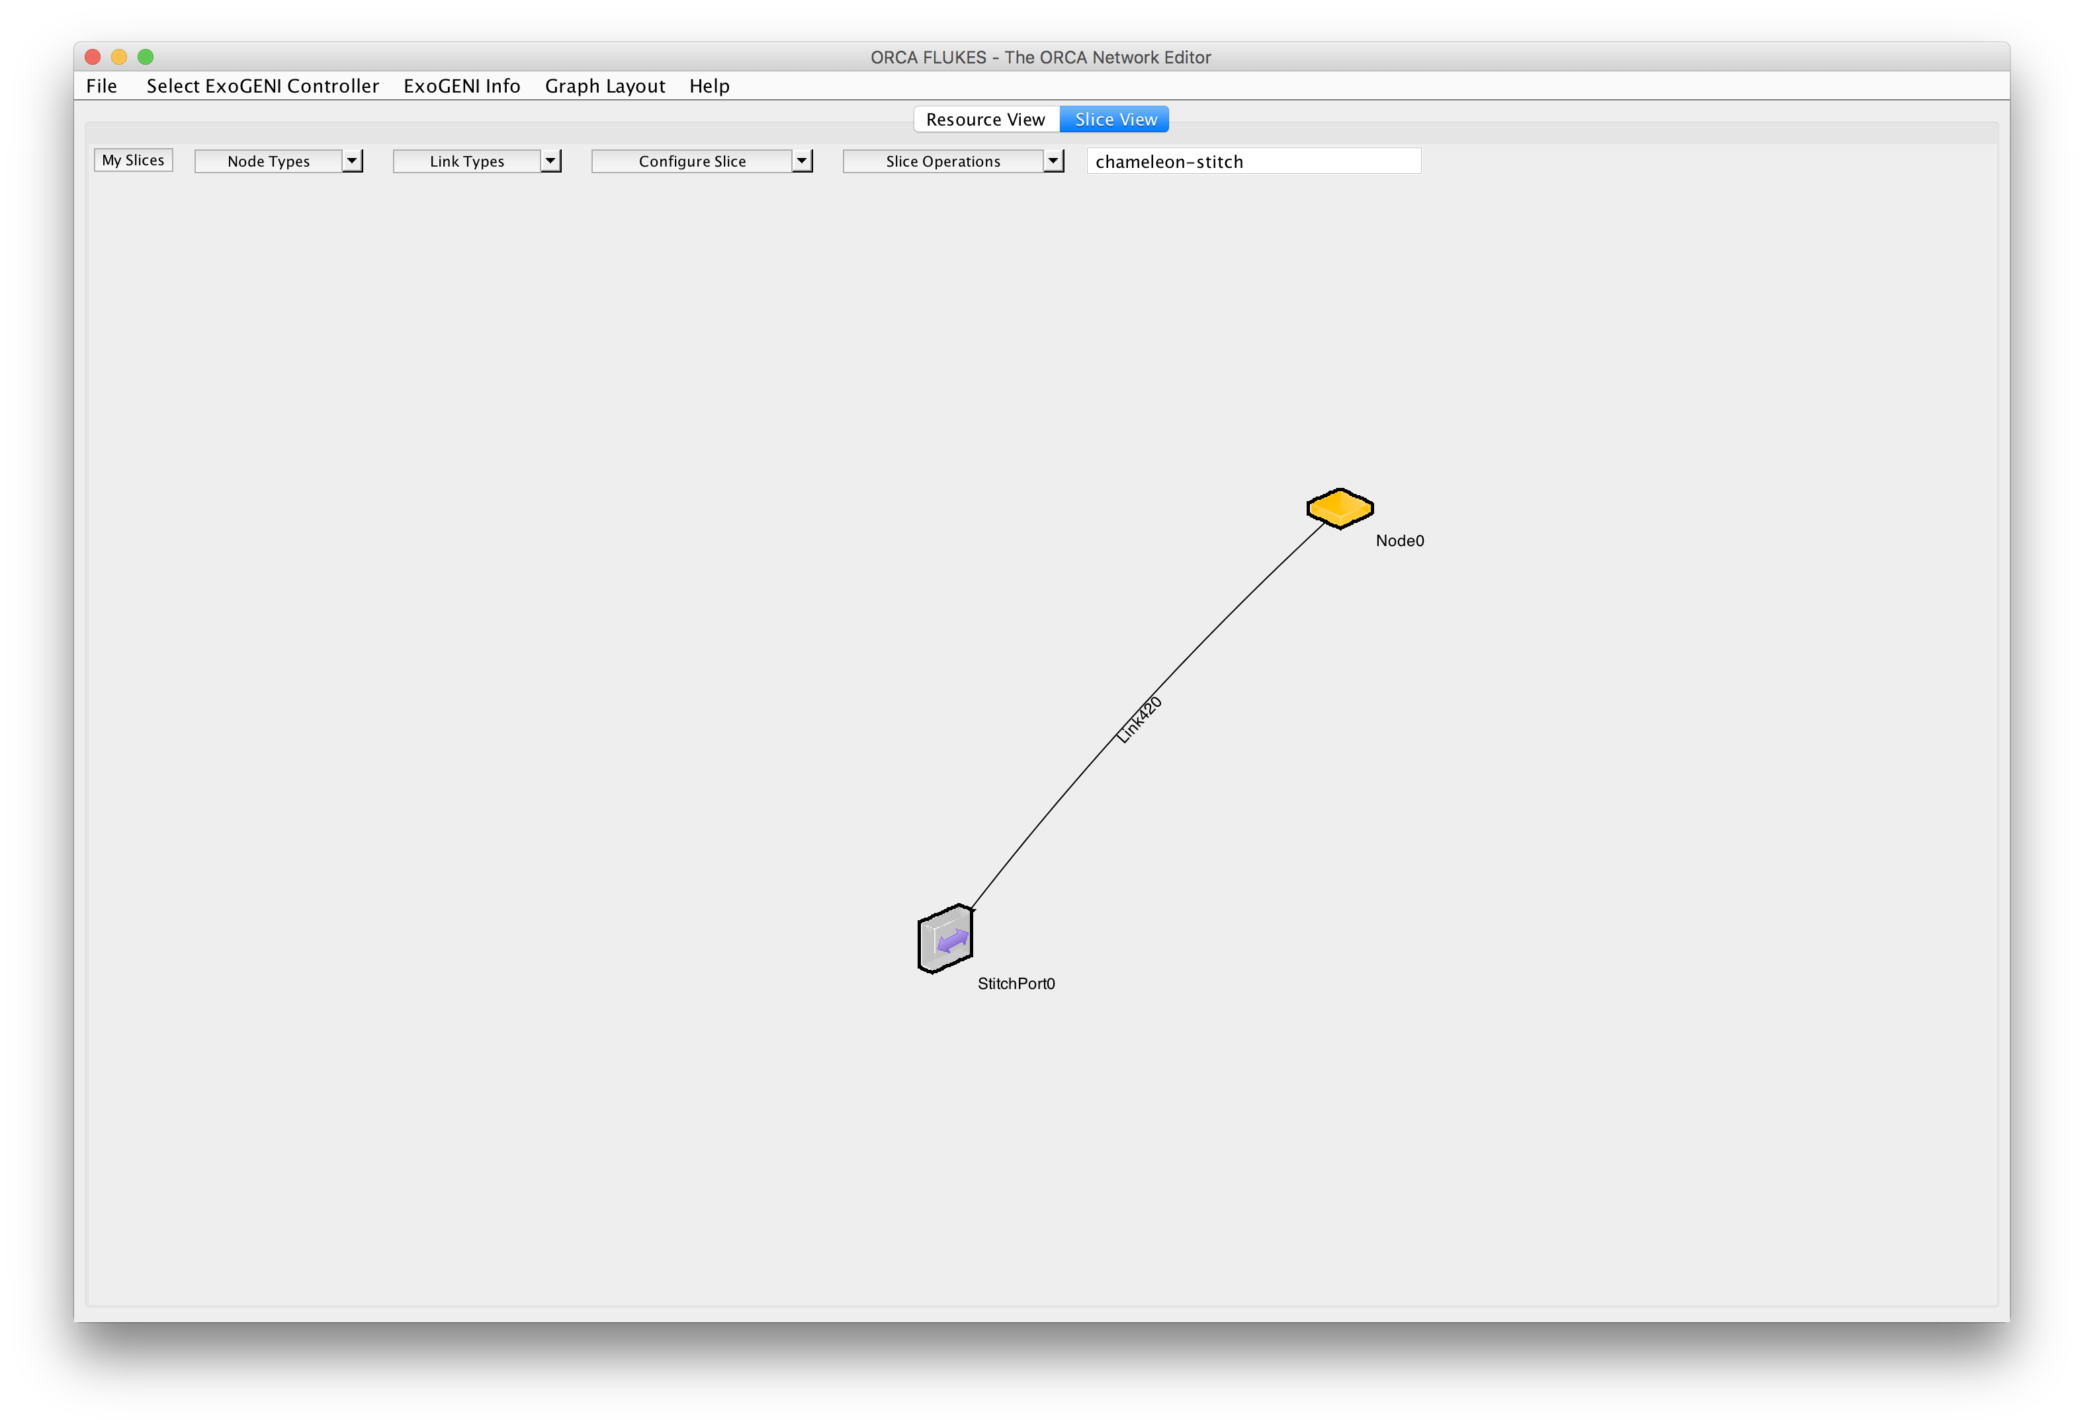
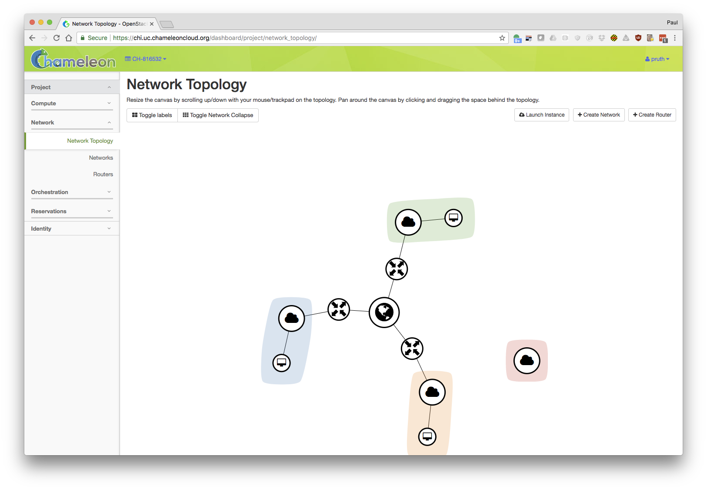
Chameleon to ExoGENI Stitching Prototype
ExoGENI slice
Dynamic Chameleon Stitchport
Stitched L2 path
Dynamic VLANs
Connectivity to ExoGENI Stitchport

Slide 11
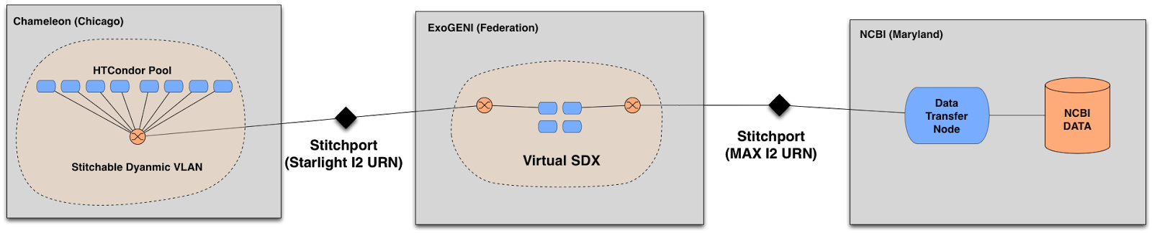


Chameleon to NCBI via ExoGENI

Slide 12
Thank You
pruth@renci.org

